Slide 1
Apache Spark Streaming
Pravin Y Pawar

Slide 2
Continuous operator model
Working
A simple and natural model
Streaming data is received from data sources (e.g. live logs, system telemetry data, IoT device data, etc.) into some data ingestion system like Apache Kafka, Amazon Kinesis, etc.
The data is then processed in parallel on a cluster.
Results are given to downstream systems like HBase, Cassandra, Kafka, etc.
Data is received from ingestion systems via Source operators and given as output to downstream systems via sink operators
Cluster has set of worker nodes, each of which runs one or more continuous operators
Each continuous operator processes the streaming data one record at a time and forwards the records to other operators in the pipeline

Slide 3
Continuous operator model (2)
Challenges
Fast Failure and Straggler Recovery
System must be able to fastly and automatically recover from failures and stragglers to provide results
Difficult to achieve due to the static allocation of continuous operators to worker nodes
Load Balancing
The system needs to be able to dynamically adapt the resource allocation based on the workload
Uneven allocation of the processing load between the workers can cause bottlenecks
Unification of Streaming, Batch and Interactive Workloads
System might have requirements to query the streaming data interactively, or to combine it with static datasets
Hard in continuous operator systems which does not designed to new operators for ad-hoc queries
This requires a single engine that can combine batch, streaming and interactive queries
Advanced Analytics with Machine learning and SQL Queries
Complex workloads require continuously learning and updating data models, or even querying the streaming data with SQL queries.
Having a common abstraction across these analytic tasks makes the developer’s job much easier.

Slide 4
Why Spark Streaming?
Provides the unification of disparate data processing capabilities
Has a unified engine that natively supports both batch and streaming workloads
Makes it very easy for developers to use a single framework to satisfy all the processing needs
Data from streaming sources can combine with a very large range of static data sources available through Apache Spark SQL

Slide 5
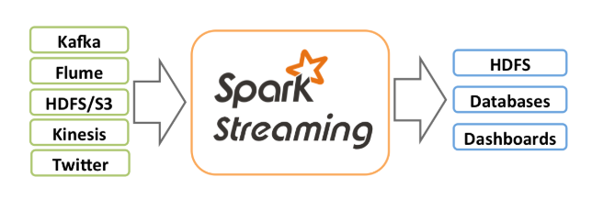
Spark Streaming
Overview
An extension of the core Spark API that enables scalable, high-throughput, fault-tolerant stream processing of live data streams
Data can be ingested from many sources like Kafka, Flume, Kinesis, or TCP sockets
Data can be processed using complex algorithms expressed with high-level functions like map, reduce, join and window
Processed data can be pushed out to filesystems, databases, and live dashboards
Can apply Spark’s machine learning and graph processing algorithms on data streams

Slide 6
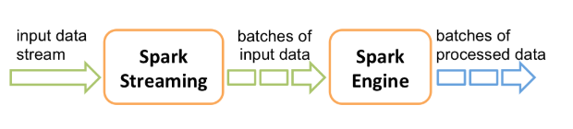
Spark Streaming (2)
High Level Working
Spark Streaming receives live input data streams and divides the data into batches
These batches are then processed by the Spark engine to generate the final stream of results in batches.
DStreams
Provides a high-level abstraction which represents a continuous stream of data
Can be created either from input data streams from sources such as Kafka, Flume, and Kinesis, or by applying high-level operations on other DStreams
Internally, a DStream is represented as a sequence of RDDs

Slide 7
Spark Streaming (3)
Micro-batching
Instead of processing the streaming data one record at a time, Spark Streaming discretizes the data into tiny, sub-second micro-batches
Spark Streaming receivers accept data in parallel and buffer it in the memory of Spark’s workers nodes
The latency-optimized Spark engine runs short tasks to process the batches and output the results to other systems.
Spark tasks are assigned to the workers dynamically on the basis of data locality and available resources.
Enables better load balancing and faster fault recovery
Each batch of data is a Resilient Distributed Dataset (RDD) in Spark, which is the basic abstraction of a fault-tolerant dataset in Spark
Allows the streaming data to be processed using any Spark code or library

Slide 8
Spark Streaming Sources & Receivers
Every input DStream (except file stream) associate with a Receiver object which receives the data from a source
and stores it in Spark’s memory for processing.
Basic sources
These are the sources directly available in the StreamingContext API.
Examples: file systems, and socket connections
Advanced sources
Sources like Kafka, Flume, Kinesis, etc. are available through extra utility classes
These require linking against extra dependencies
Reliable Receiver
Is the one that correctly sends an acknowledgment to a source when the data receives and stores in Spark with replication
Unreliable Receiver
Is the one that does not send an acknowledgment to a source

Slide 9
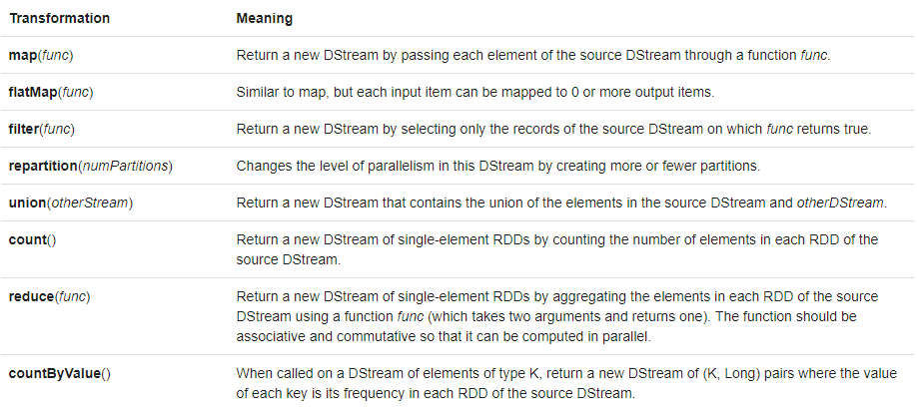
Spark Streaming Operations
Transformation Operations
Spark transformations allow modification of the data from the input Dstream
Source : https://spark.apache.org/docs/latest/streaming-programming-guide.html#transformations-on-dstreams

Slide 10
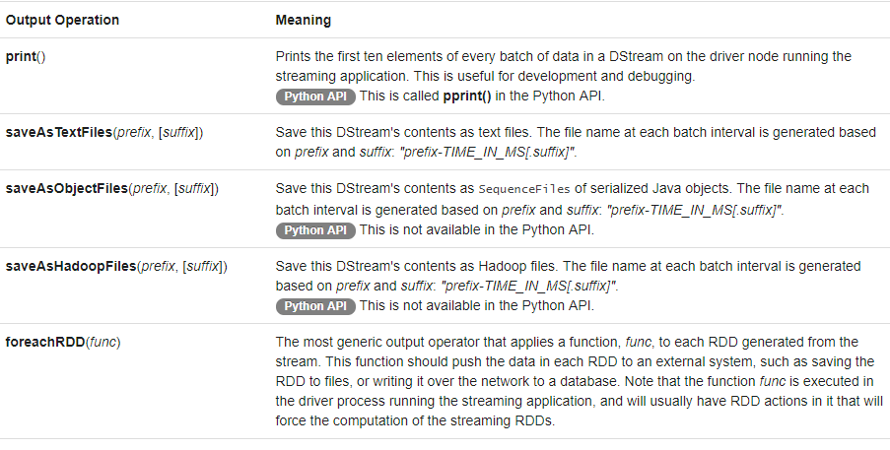
Spark Streaming Operations(2)
Output Operations
Output operations allow DStream’s data to be pushed out to external systems like a database or a file systems
Source : https://spark.apache.org/docs/latest/streaming-programming-guide.html#output-operations-on-dstreams

Slide 11
Thank You!
In our next session: Apache Kafka Streaming

